Slide 1
CITYNEXUS
How DestinE can empower sustainable cities​

Slide 2
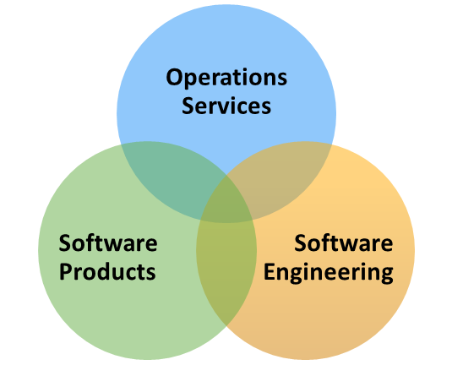
Solenix: Services & Expertise
International team of 70+ highly qualified staff in Germany, Switzerland and Italy
19 years of experience, 8 MEUR turnover
Flexible, solution-oriented work approach
The
Company
Spacecraft Operations
Ground Segment Engineering
Payload Data Ground Segment Engineering
Data Processing
EO Science and Applications Engineering Support
EO Exploitation Platforms Engineering Support
Research of Advanced Technologies Concepts
AI/ML Specific Expertise & Consultancy
Operations
Services
Machine Learning
Anomaly & novelty detection, Prediction
Pattern matching, Trend analysis
Planning & Scheduling, Optimization
Automation & Autonomy
Artificial
Intelligence

Slide 3
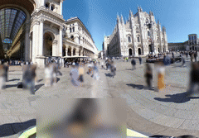
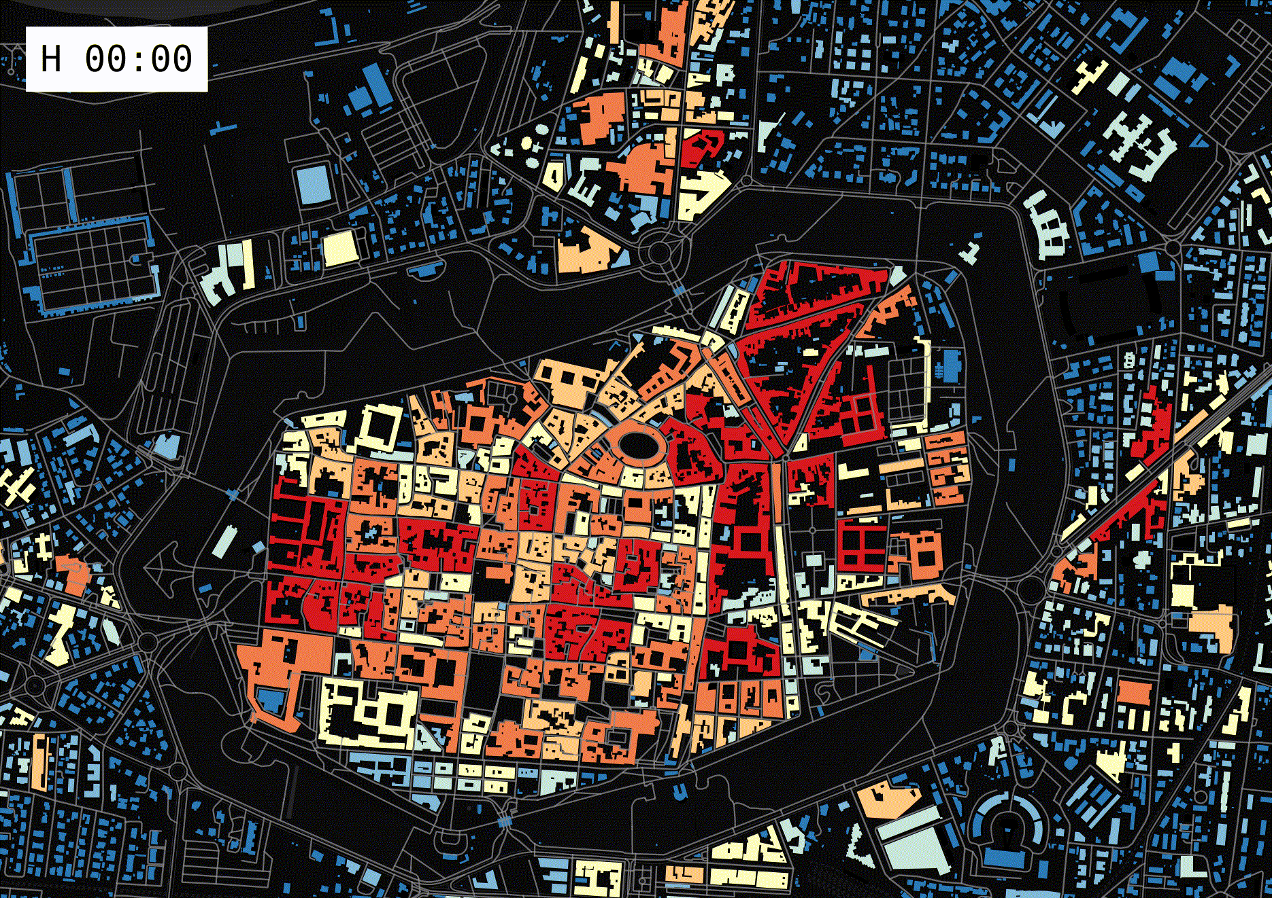
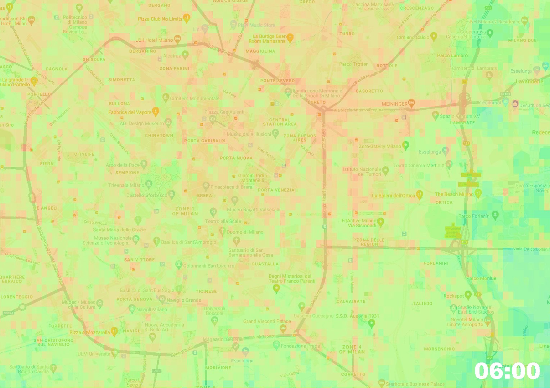
MindEarth: Location-driven Intelligence
The
Company
local scale
regional scale
global scale
Mobile mapping and information extraction
Human flows and POIs from mobility data
Spatial inference from satellite data
through ML/AI
Operations
Services
Near Surface NO2 [µg/m³]
0
>120
Artificial
Intelligence

Slide 4
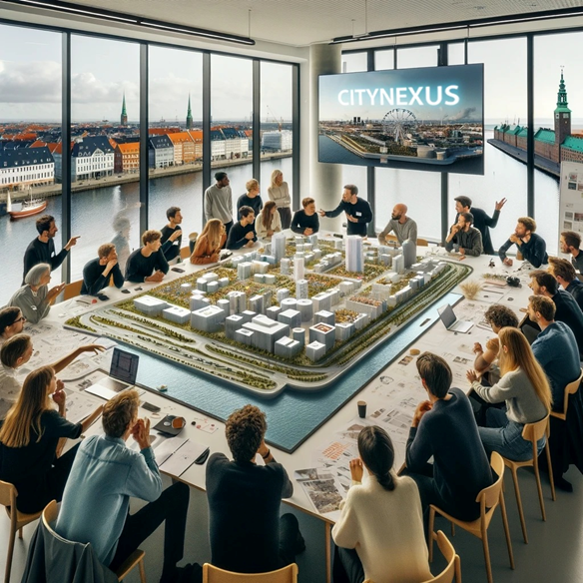
CITYNEXUS Service
Urban DT Application for sustainable urban interventions
Collaborative platform to experiment strategies and solutions:
Evaluating diverse factors and variables
Facilitating a coordinated approach to evidence-based decision-making at municipality level
Interactive system
Assessing the impact of infrastructural and mobility changes
Policy-relevant, user-defined ‘what-if’ scenario simulations

Slide 5
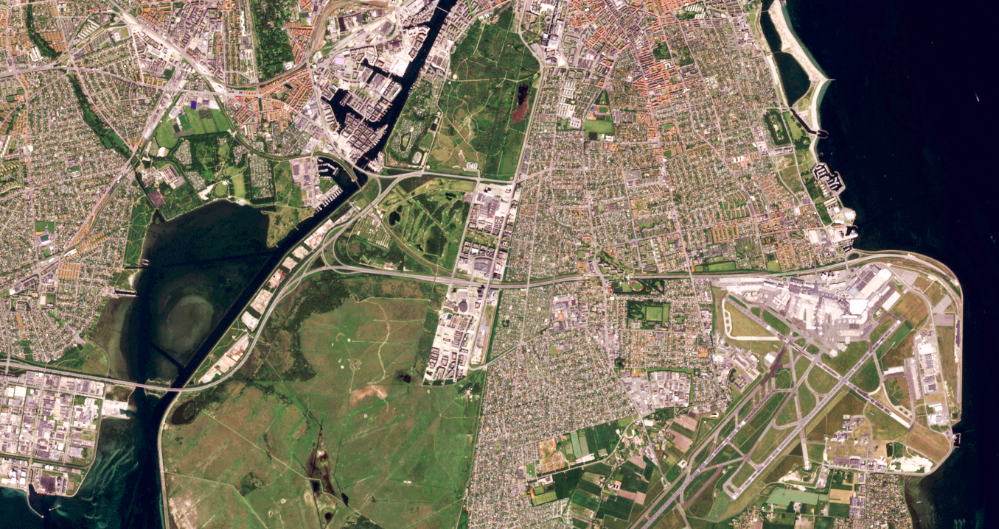
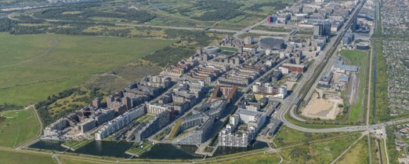
The Challenge: transforming Ørestad
The City of Copenhagen and the Local Council of Amager Vest (LCAV) aim to reduce traffic congestion and promote urban quality of life. ​
A key proposal involves transforming high-speed roads in Ørestad (Amager Vest), a diverse area near the city center with about 25,000 residents, to reduce traffic, improve air quality, and enhance living spaces.​
Inspire other districts and municipalities to match mobility and economic needs with climate action and environmental health.​

Slide 6
Citynexus: Aims and Objectives
Evaluating baseline conditions for human mobility and other connected KPIs:
Dynamic Population Distribution,
Service Accessibility,
Air Quality and
Public Environmental Health;
Enabling the interactive assessment of the impact of infrastructural and regulatory changes through live ‘what-if’ scenarios;
Implementing data-driven, innovative approaches for urban planning and climate policy.

Slide 7
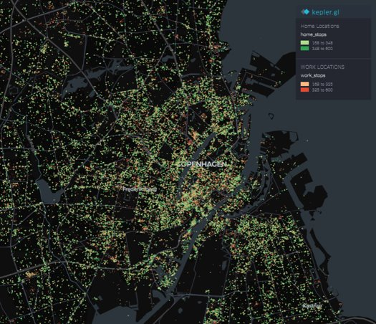
Understanding Mobility with HFLB Data
We rely on commercial High-Frequency Location Based data (HFLB) that is data precisely tracking the location of a GPS-enabled logging device in time.
This is used to provide key insights into:
commuting patterns,
travel behaviour,
traffic flows,
congestion rates,
peak traffic hours,
overall mobility dynamics.

Slide 8
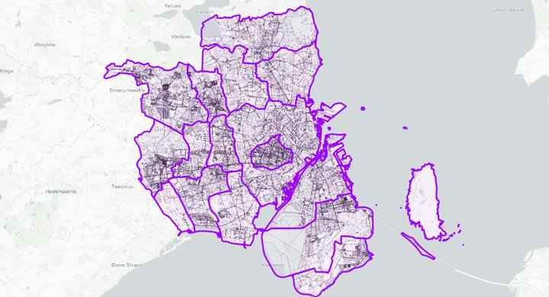
Citynexus: Area of Interest

Slide 9
'What if' scenarios
Users are given the possibility to assess the effects of different interventions in a virtual space.
Electric, Low-Emission Vehicles and Active Mobility
​Road Speed
Adjustment​
​High-speed Road Redesign
Low Emission Zones (LEZ) Creation
Change POIs and population
?
IMPACT ON TRAFFIC CONGESTION
IMPACT ON AIR QUALITY

Slide 10
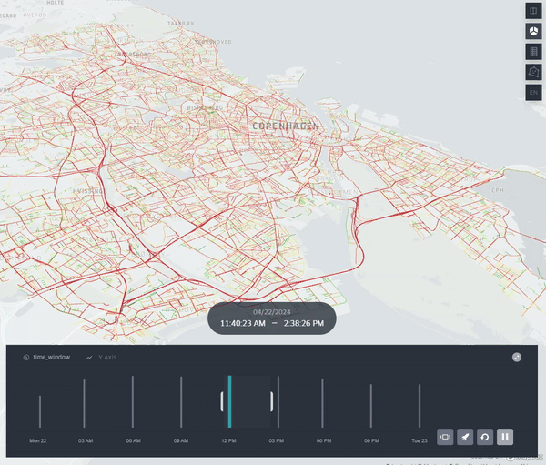
Simulation outputs
16(x5) possible configuration variations for each simulation:
Pollutants: up to 5 different pollutants (CO2, CO, HC, NOx, PMx);
Statistics for each vehicle: (Fuel Consumption, Speed, ...);
Time Slots: 8 individually selectable time windows, each representing a 3-hour block.
Day Selection: Option to choose between a weekday or weekend.
Periodicity: Yearly.

Slide 11
User Support
Interactive, web-based visualization based on kepler.gl
OpenAPI
Scenario Definition
Simulation
Evaluation

Slide 12
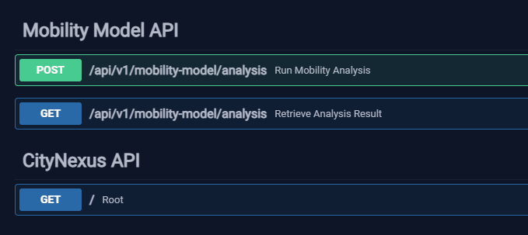
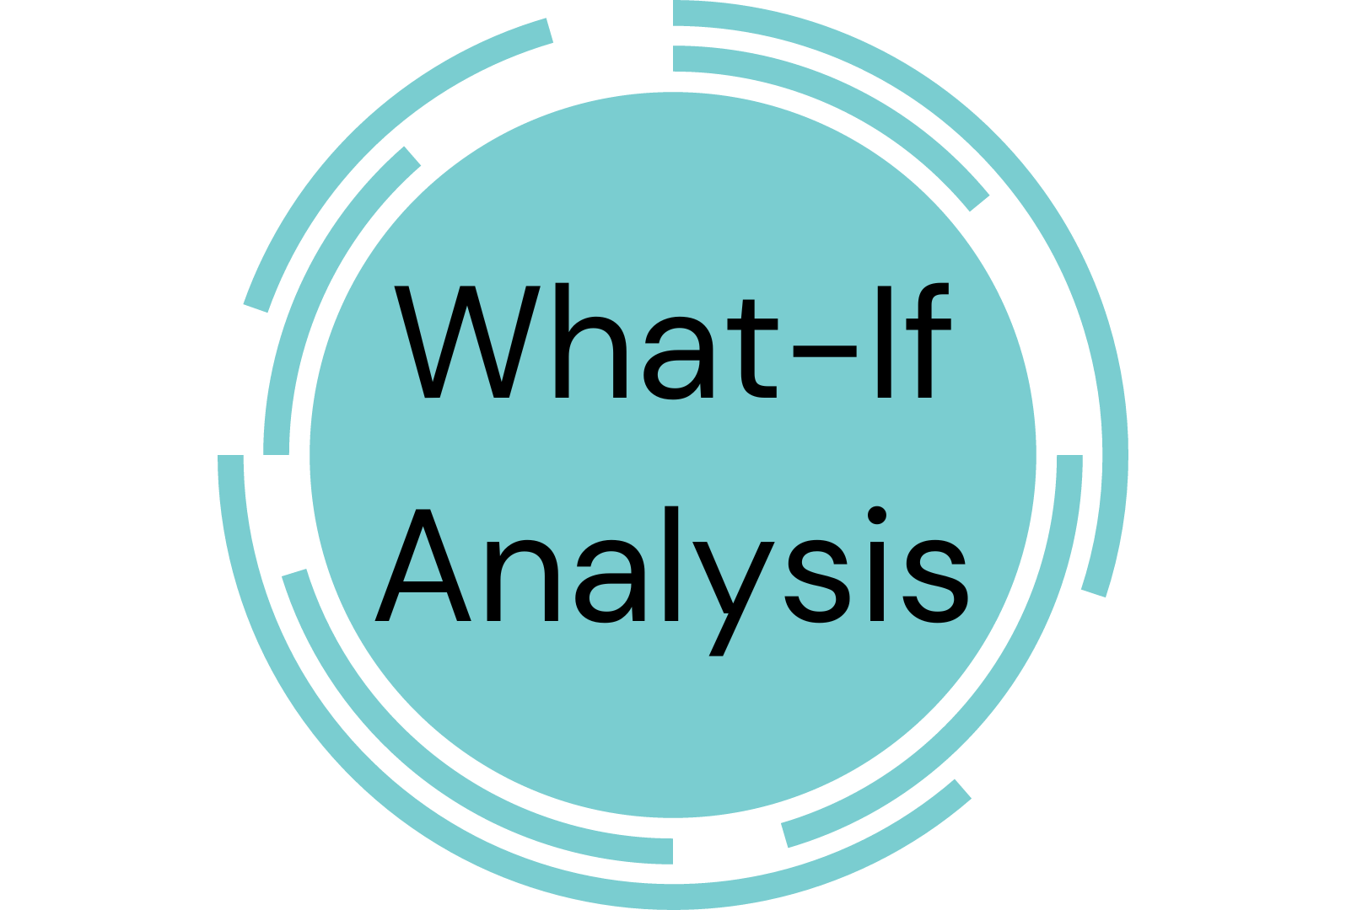
User Workflow
Data
Analytics
Visual
Inspection
Scenario
Generation
New
Scenario(s)

Slide 13
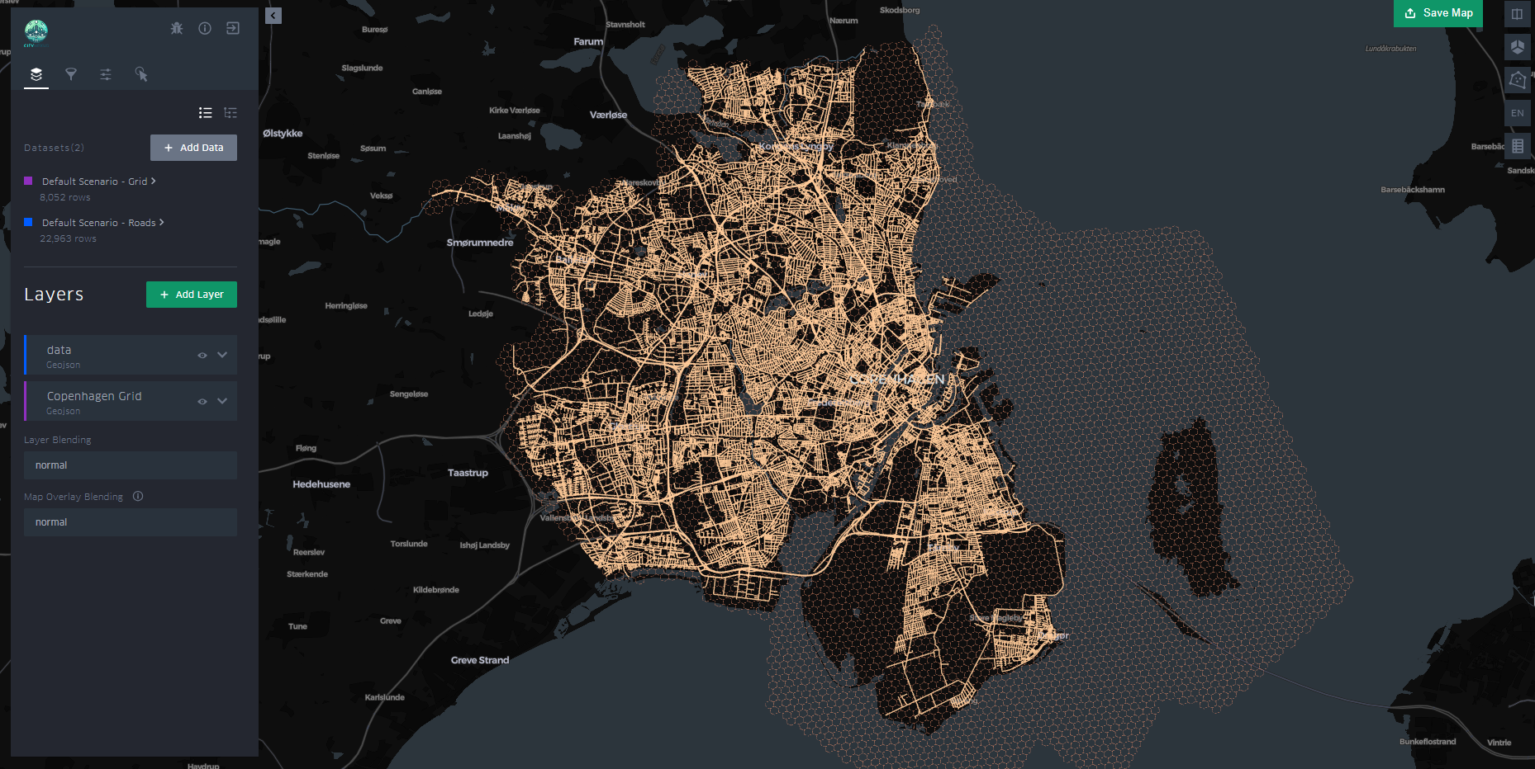
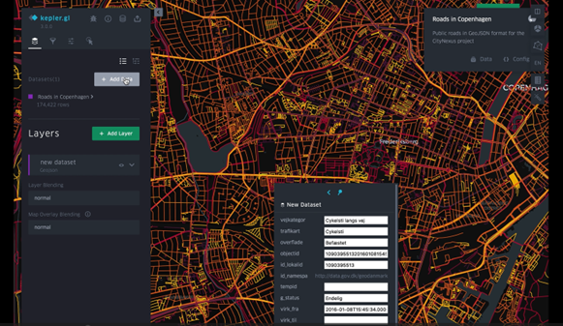
Scenario Definition
Road Segment Properties
Map Zones Properties
Simulation Parameters

Slide 14
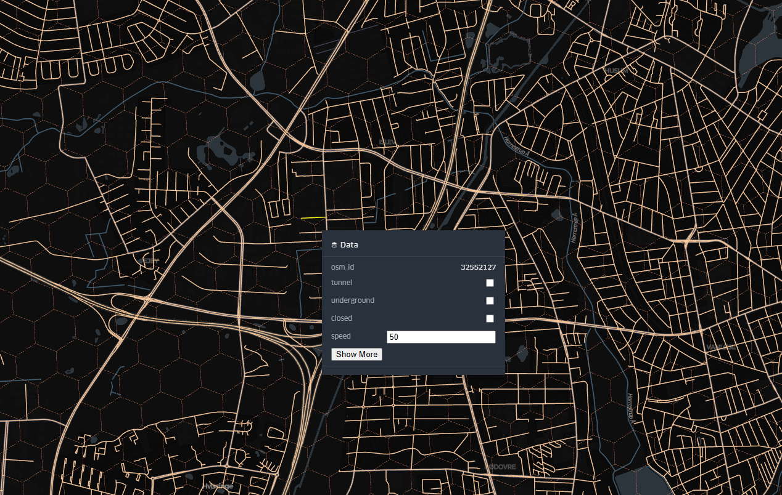
Road Segments Scenario Definition
Road Segment Conversion: Modify road segments to be above ground or underground, tunneled or not.
Average Speed Adjustment: Change the average speed limit of a specific road segment.
Road Segment Accessibility: Control access to a road segment for all or specific types of traffic.

Slide 15
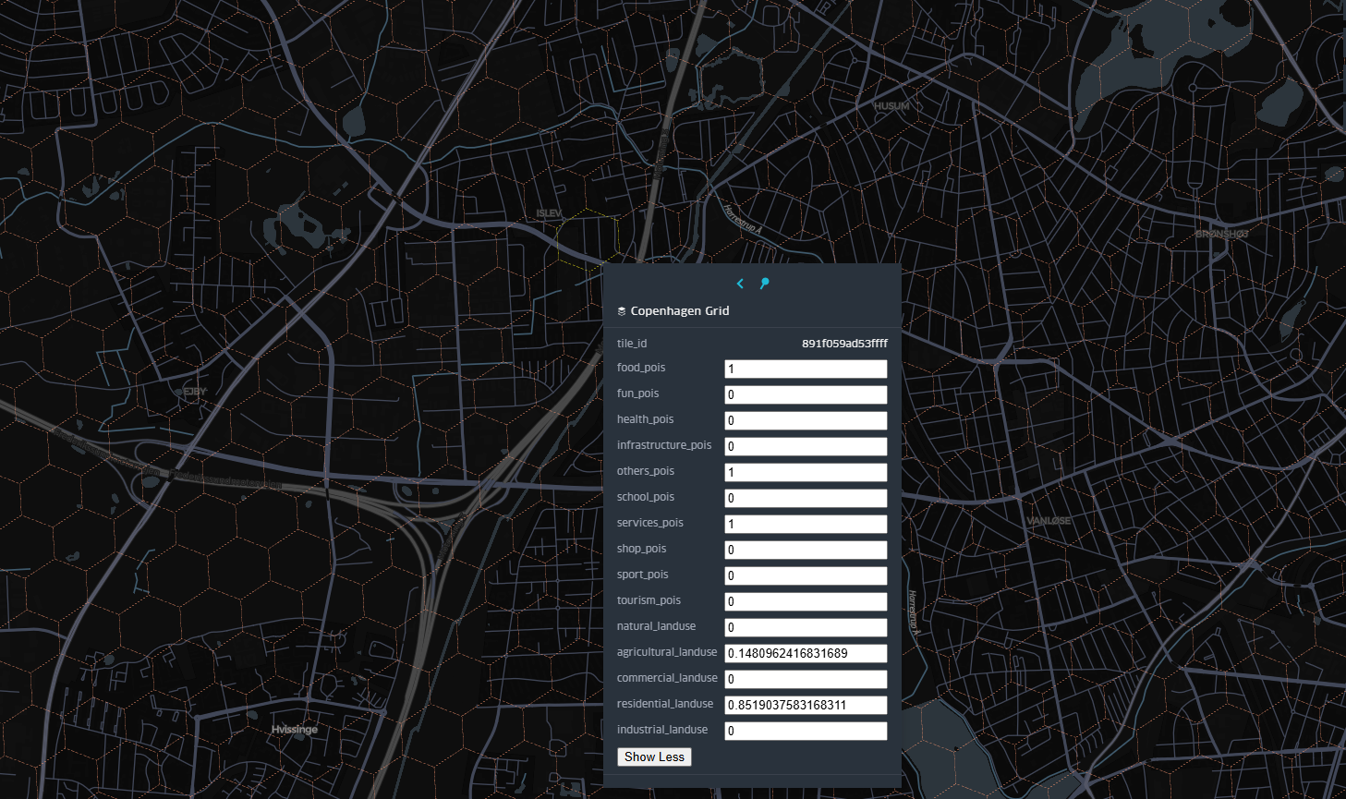
Zone Scenario Definition
Landuse: Defines the ratio of the area covered by 4 types of land usage: Residential, Commercial, Agricultural and Industrial
Point of Interest (POI) Management: Increase or decrease the number of POIs across various categories within the simulation.
Population Dynamics: Adjust population levels to reflect increases or decreases in the simulated area.

Slide 16
Simulation Parameters
Time Slots:
8 individually selectable time windows, each representing a 3-hour block.
Day Selection:
Option to choose between a weekday or weekend.
Traffic Composition Weighting:
Alter the proportionate impact of different vehicle types (electric vehicles, bicycles, cars) on total traffic

Slide 17
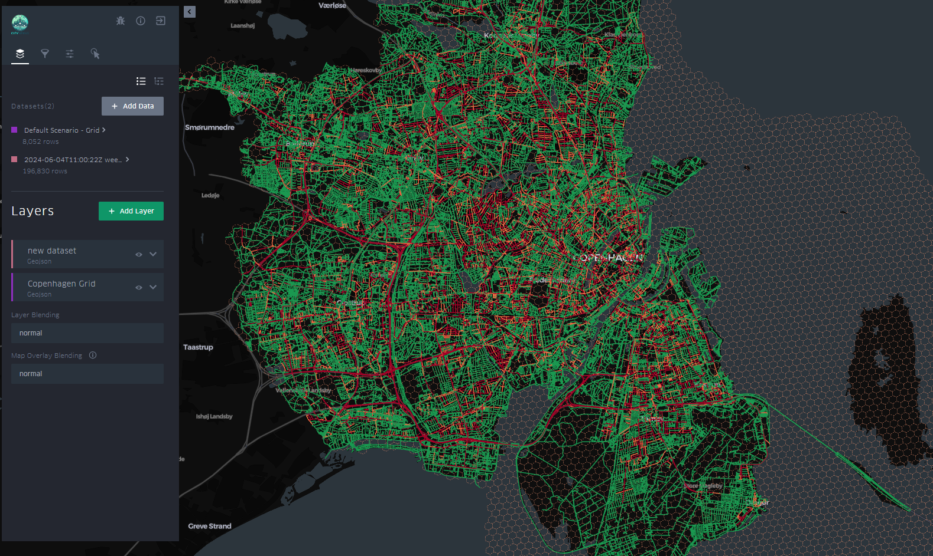
Analysis
Pollutants: up to 5 different pollutants (CO2, CO, HC, NOx, PMx)
Statistics for each vehicle: (Consumption, Speed, ...)
Comparative Analysis
XAI Sensitivity Analysis

Slide 18
DestinE Integration

Slide 19
CITYNEXUS on DestinE
CITYNEXUS is “Coming Soon” on DestinE
Platform
Digital Twin
Data Lakes

Slide 20
CITYNEXUS on DestinE
Market Place for EO Applications
Visibility
Deploying support
Operational Environment
Accounting Management
DT Interoperability
CITYNEXUS Provides data for DT
CITYNEXUS Profits from DT data

Slide 21
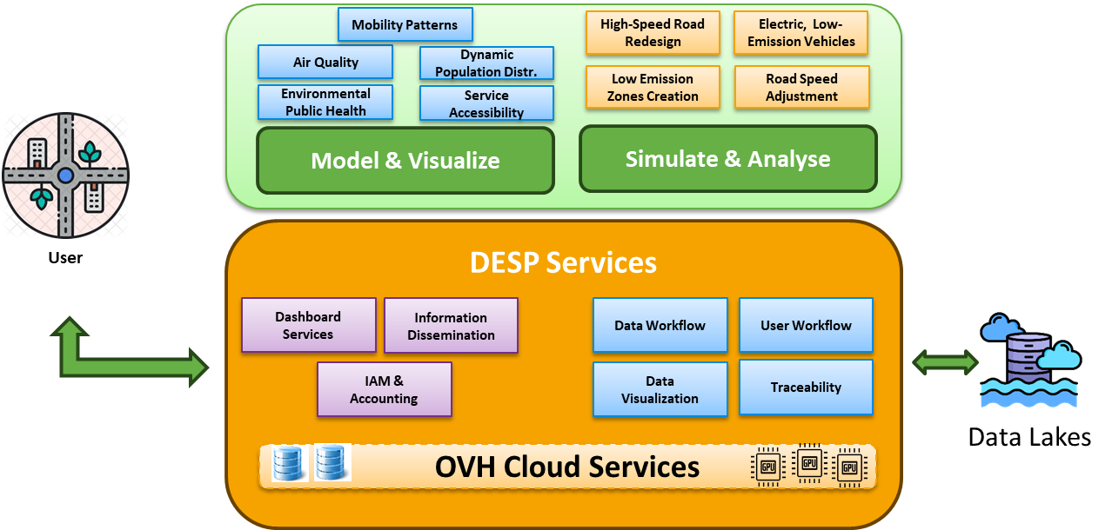
CITYNEXUS on DestinE

Slide 22
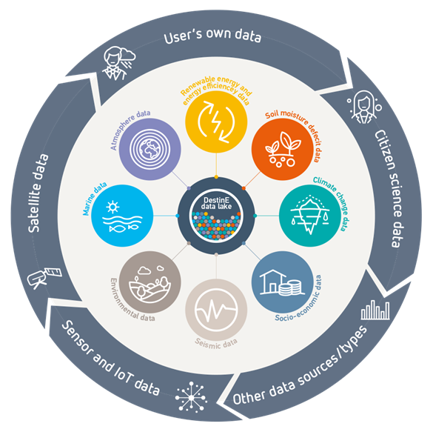
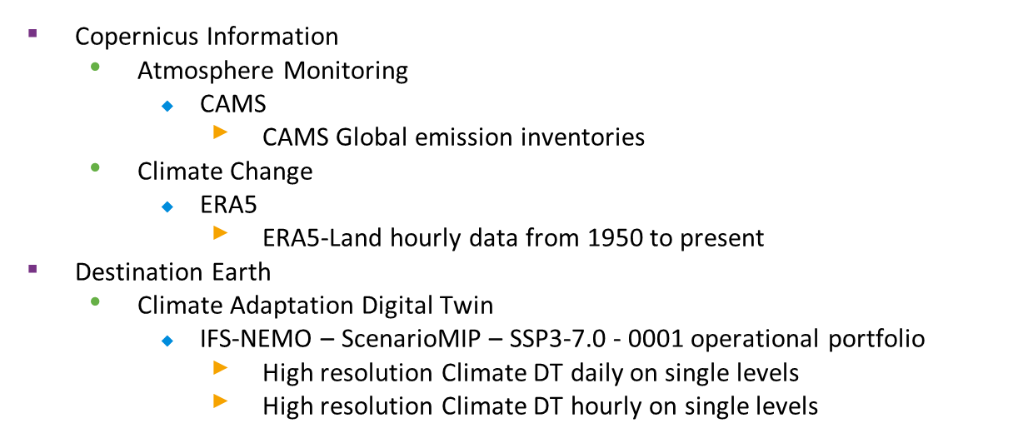
CITYNEXUS on DestinE
The DestinE Data Lake provides seamless access to DestinE Digital Twins data and large number of external data spaces

Slide 23
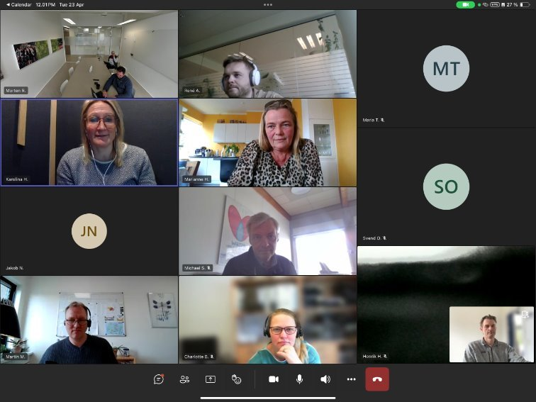
Building a more resilient Copenhagen together
Bilateral meetings with LCAV and follow-ups with major players (Vejdirektoratet, sund&Baelt, By&Havn): interest in using digital twins as part of citizen engagement process​
Hybrid Workshop attended by LCAV and 10+ municipalities: interest in using ‘real-time’ calculation of consequences of change to urban space;​
City of Copenhagen: interest in learning about digital twins and potential use for planning activities.​

Slide 24
Spreading the word
Maximize impact and ensure the adoption of project outcomes through dissemination:
Participate to international conferences and events (ESA Urban Insights from Space 2024)
Presentations at major community events and bespoke project events (Climate Awareness event in Copenhagen)

Slide 25
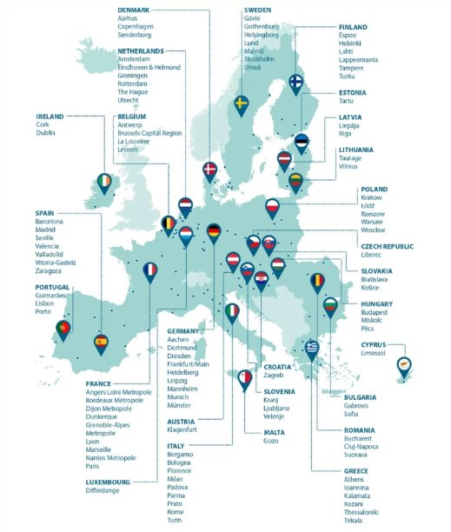
Growth and Scalability
Showcasing the capabilities of Citynexus for policymaking and urban planning
Future expansion of services to cover multiple Danish cities and scaling up to European cities, focusing on high-impact precursors.
Strategic partnership with data providers to ensure the most up-to-date data is always integrated.
Possibility to implement a flexible service (i.e. free tier vs. commercial tier).

Slide 26
Thank You

