Slide 1
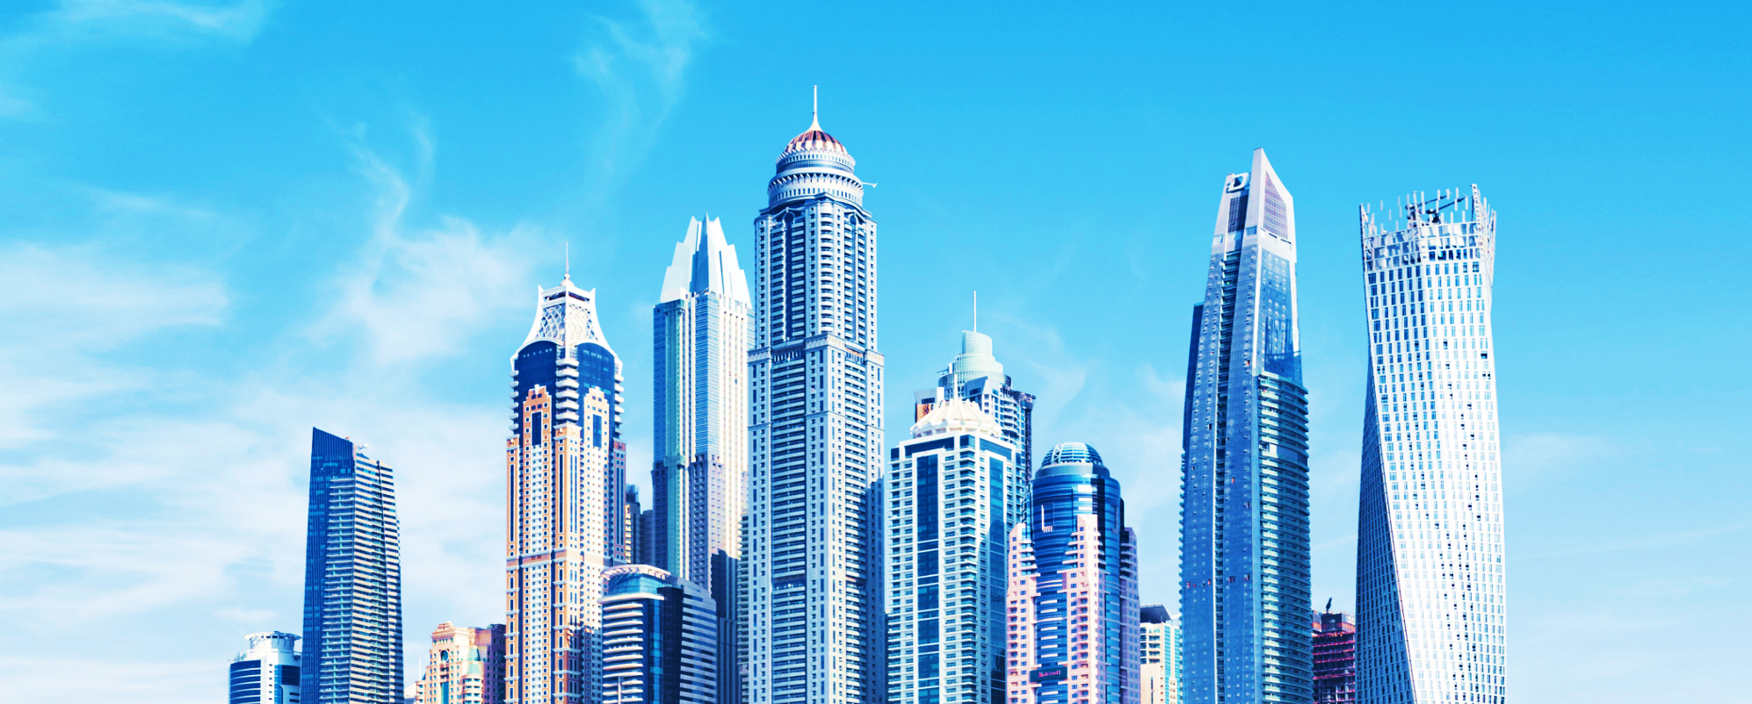
UrbanSquare: DestinE Empowering Urban Resilience Against Climate Challenges
Roadshow Webinar
9 July 2024 | 11:00-12:00 CEST

Slide 2
Agenda
Introduction
The Challenge: understanding and mitigating the impacts of heat waves, storms, air pollution, flooding, and infrastructure disruptions
UrbanSquare: What does the tool do?
The impact of DestinE: how UrbanSquare is enhanced
The plan for scale-up: how UrbanSquare can have a wider impact
Audience Q&A

Slide 3
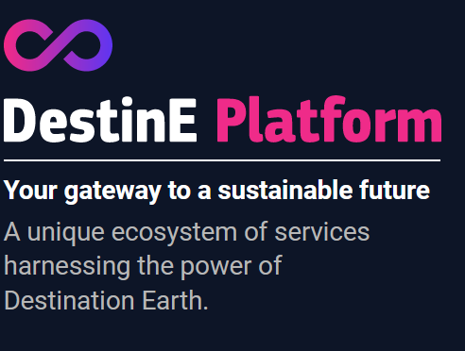
Introduction
5 DestinE use-cases
GFTS
DESIDE
CityNexus
DRE
UrbanSquare

Slide 4
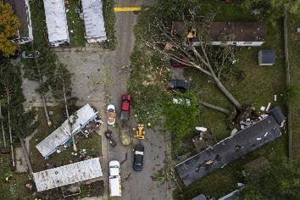
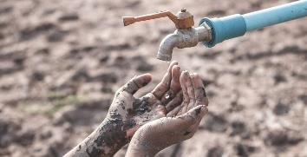
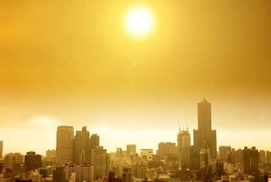
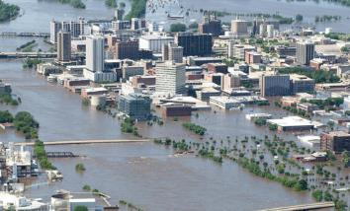
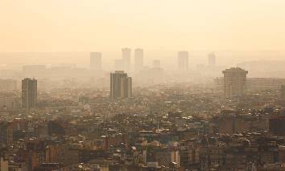
The Challenge
Infrastructures
Resources
Sea level rise & storm surges
URBAN SQUARE
Heat waves
Flood
Air pollution

Slide 5
Flood
Focus: what is the challenge that municipalities are facing regarding flooding ?
Climate change: recent years river discharge across Europe
Lower than average 2/3 of the year
November and December 158 flood notifications
https://climate.copernicus.eu/ESOTC/2019/river-discharge
This has important impact on the climate conditions in the entire continent.

Slide 6
Flood
Municipalities
Engaged in emergency response situations
Comply with national level emergency response regulations
Implement centralized flood risk reduction measures
Face damage control needs
Responsible for the population
Identify and plan the recovery of urban infrastructure
Relate and cater to inundated agricultural fields
etc.
Need
Get warning about an upcoming flood way in advance
Get indication about the flood span and the size of the damages
Plan in compliance with the emergency response regulations
Get information about what resources will be needed for recovery
Be able to plan based on what-if scenarios

Slide 7
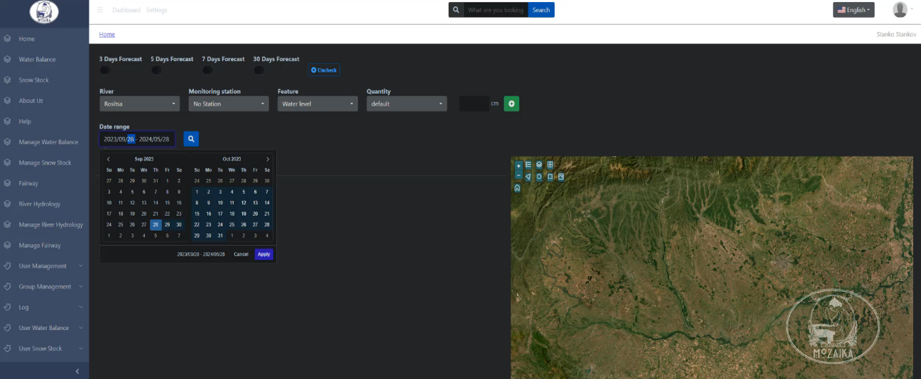
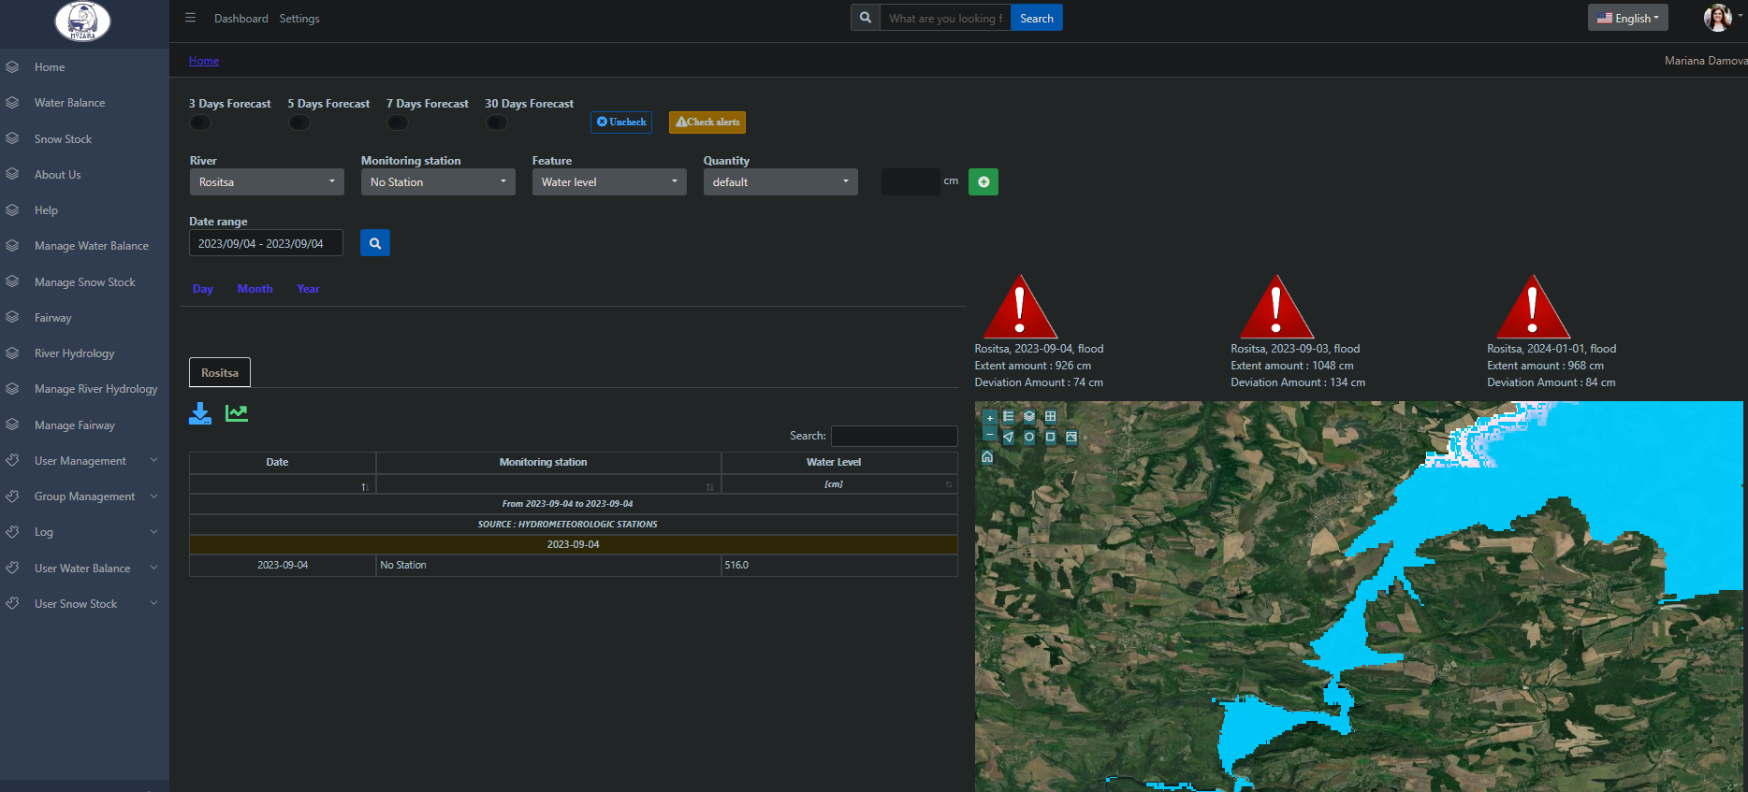
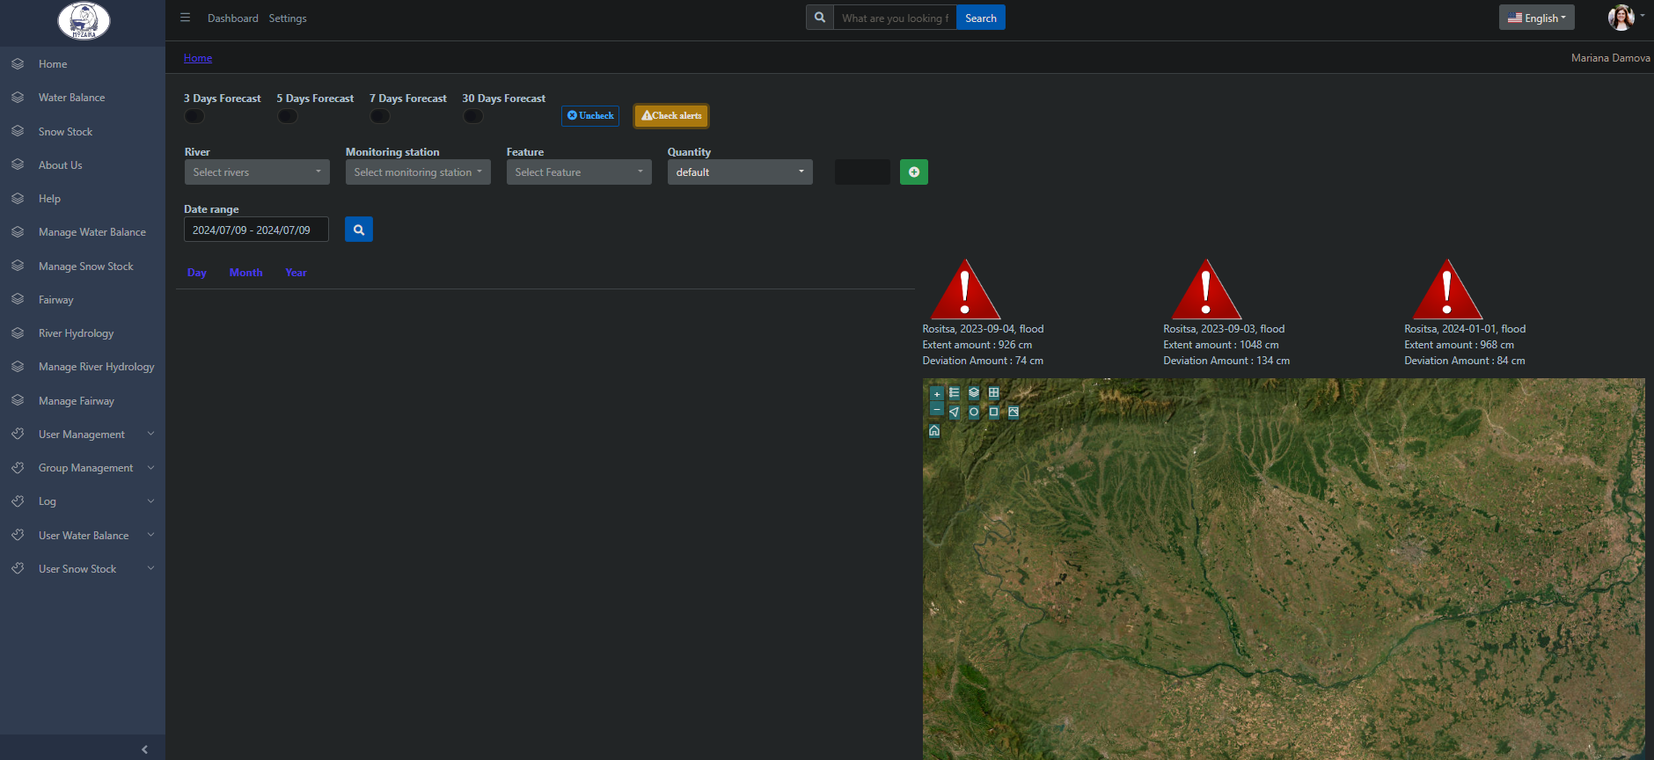
Flood

Slide 8
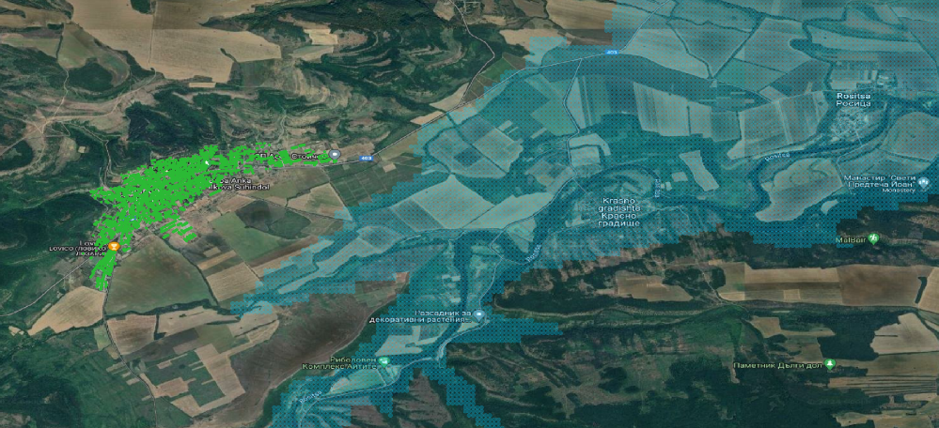
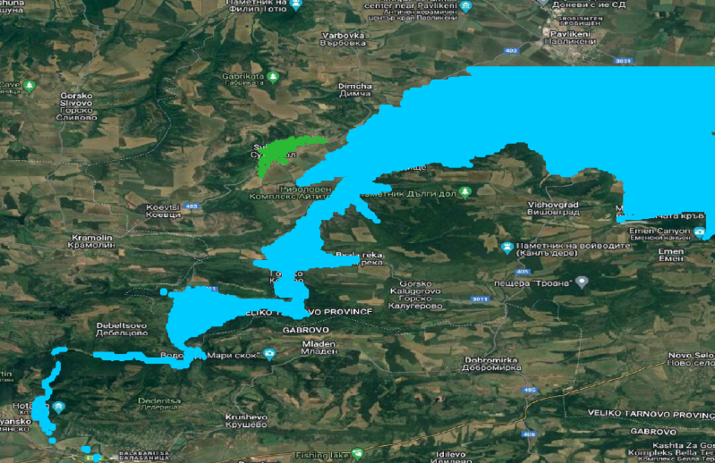
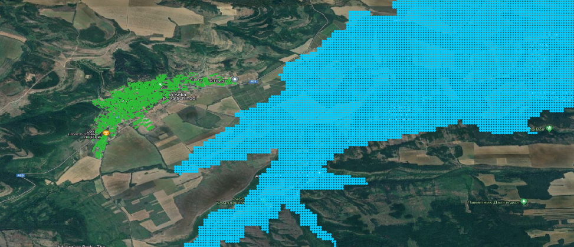
Flood span and damages evaluation

Slide 9
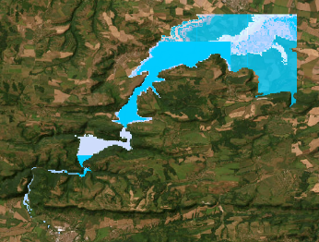
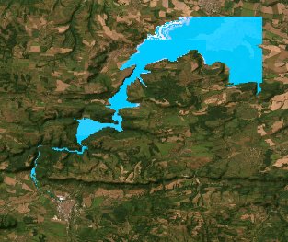
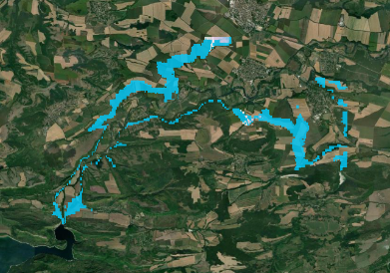
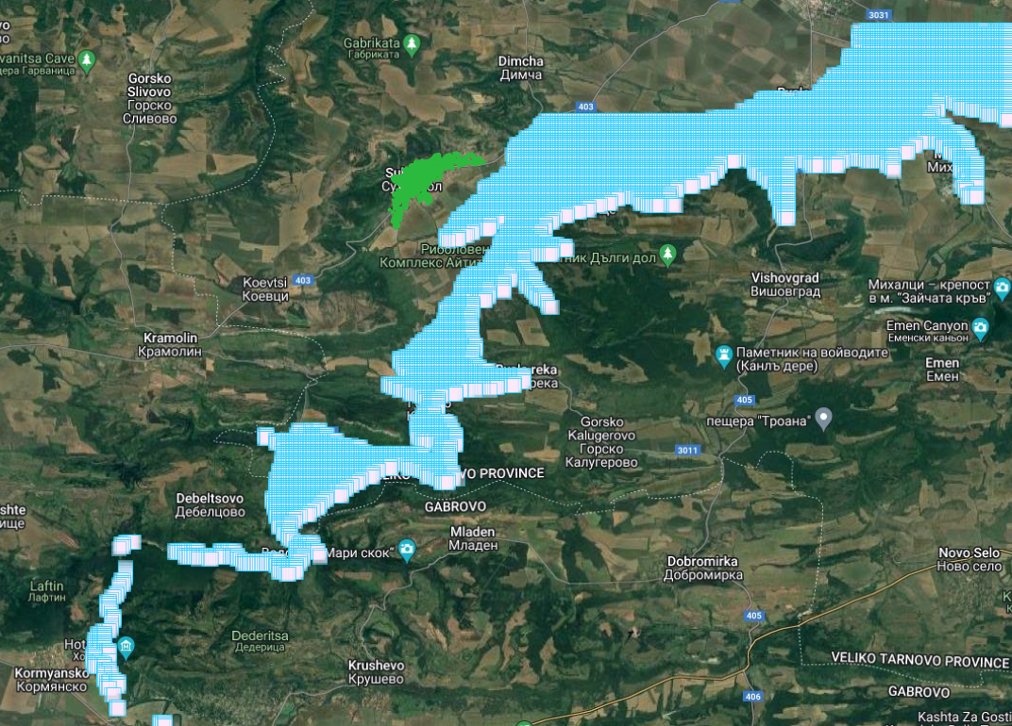
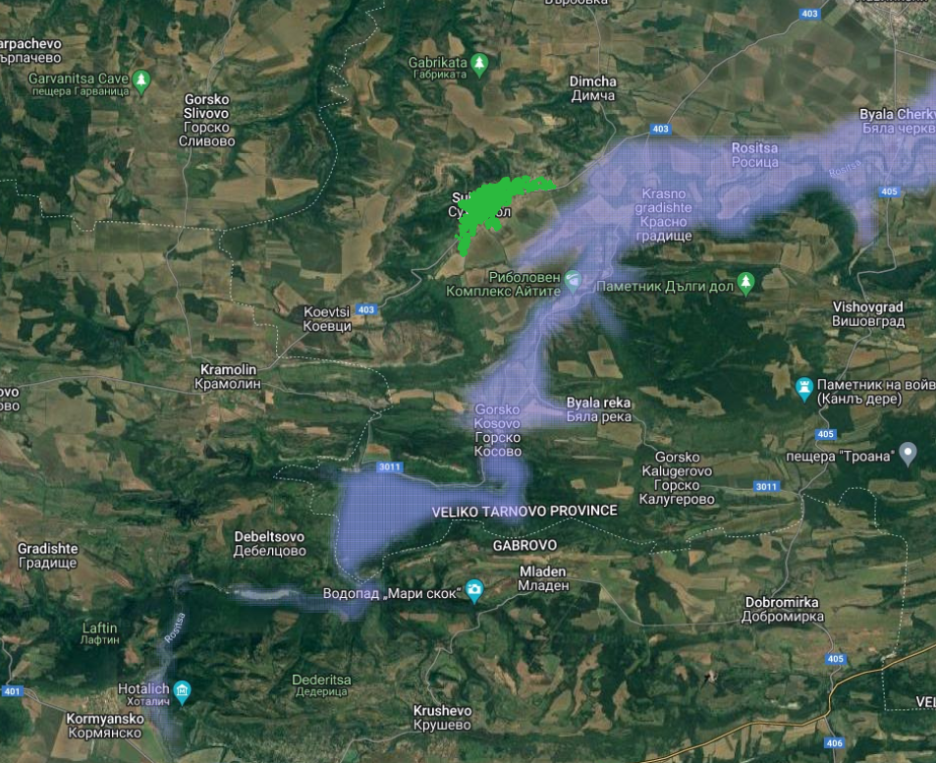
Flood forecasting and simulation
EO4AI to forecast water levels and river discharge for 30 days ahead and more
Simulation with increased of discharge and precipitation levels and elevation models
Design and experiment with What-if scenarios via administrative GUI
DestinE integration
Go global
Copyright © Mozaika

Slide 10
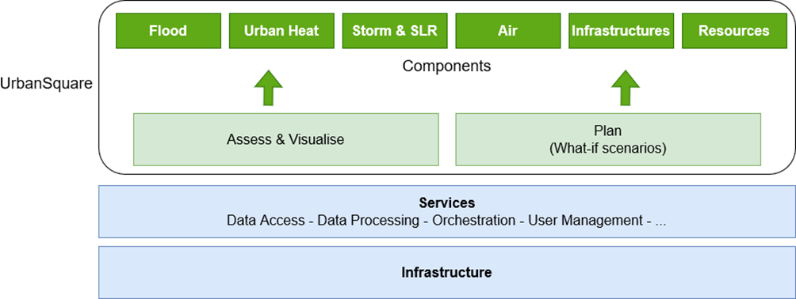
What does the tool do ?
DestinE

Slide 11
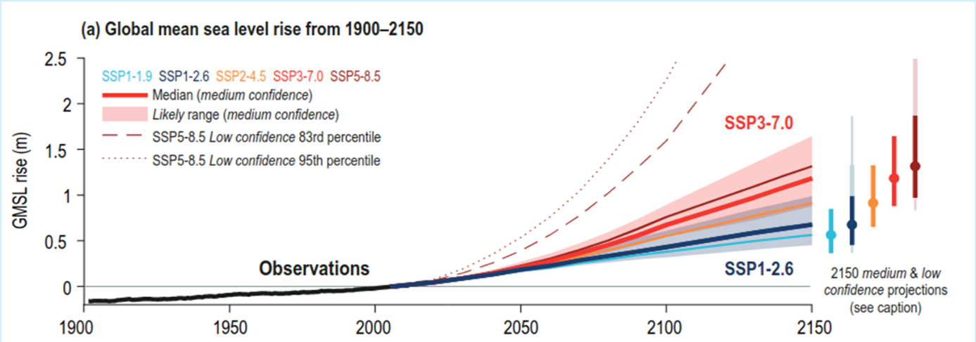
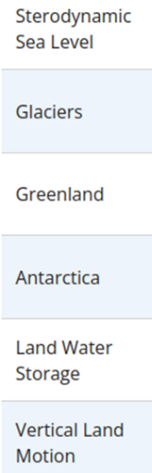
Sea Level Rise and Storm Surge
Focus: Anticipating sea level rise and storm surges
What-if Scenarios for Long-term Inundation Risk Assessment
Notes:
Sea level rise is one of the most significant effects of climate change and it poses a threat especially to urban areas along coastlines, as it will be affecting infrastructures and industries and lead to population displacement.
The Graph shows the Global Mean Sea Level Rise projection derived by the IPCC, the Intergovernmental Panel on Climate Change in meters until the year 2150.
According to the IPCC climate projections, the risk of sea level rise increases for each shared socioeconomic pathway, or SSP. The SSPs are climate change scenarios that take into account future socio economic global changes. There are 5 SSPs: the first one is the more optimistic one, in which it is assumed that society will be taking “the green road” towards a more sustainable planet, while the last one is the most pessimistic one, that assumes a completely fossil-fueled development. The Projected Data takes into account different components that contribute to Sea level Rise, such as melting glaciers.
The Urban Square Demonstrator intends to give an insight into these global future changes by implementing a technical service that allows to map far-future inundation risk in any area of the globe.
such as Sterodynamic Seal Level (heat expansion), melting glaciers, Greenland ect.
The Projections are shown for each shared socioeconomic pathway SSPs are also shown with their Confidence interval.

Slide 12
Sea Level Rise and Storm Surge
What-if Scenarios for Long-term Inundation Risk Assessment
Inputs:
Copernicus DEM
ESA Waterbodies
IPCC AR6 projections
Copernicus Gobal Human Settlement Layers
Outputs:
30m Inundation Map
Damage Assessment: Affected population, urban area and cultivated area
Model Configuration:
Global inundation risk service
Projections from 2040 - 2150
5 Shared Socioeconomic Pathways (SSPs)
7 Storm Surge Height options
Medium and Low Confidence Level
Notes:
The service is based on the copernicus 30m DEM, the ESA waterbodies layer and the the IPCC sea level projections.
In particular, for the latter, the 50th percentile of each SSP was selected.
The data is also distributed in two categories of confidence levels (medium and low). This Levels of certainty are based on the evidence and agreement among scientists about the projected outcomes. The confidence levels in IPCC reports are used to convey the degree of certainty in scientific findings and predictions, which are determined through the consistency of evidence, the robustness of methodologies, and the level of agreement among experts.
Medium: "About 5 out of 10 chance"
Low: "About 2 out of 10 chance"
The model configurations
inundation risk service we provide can be quickly set up by choosing 4 parameters. The first one is the year of interest, do you want to look at the situation in 2040 or 2150? Then you can choose the SSP scenario. Then the user can add a storm surge height to the projected sea level rise, up to 50m. And finally you can choose between a low and a medium confidence level. The user can test out several what-if scenario as all parameters can be easily changed.
the outputs
through an api that calls the ghs layers

Slide 13
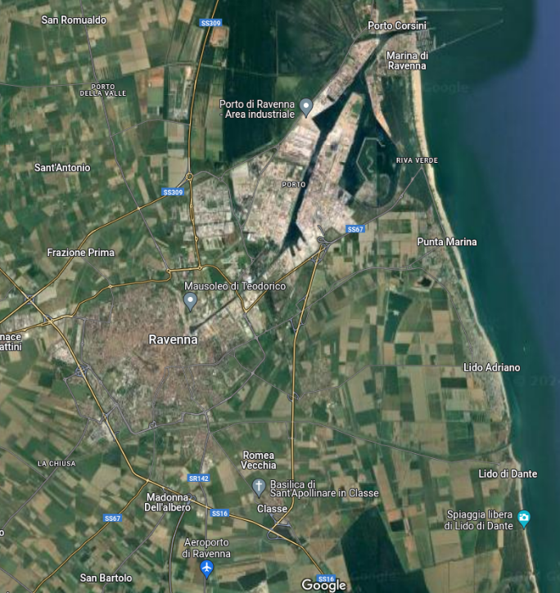
Sea Level Rise and Storm Surge
What-if Scenarios for Long-term Inundation Risk Assessment in Ravenna and nearby areas
What is the risk of inundation in the future?
Are the prevention strategies applied today going to be enough?
Will the inhabitants be at risk?
Which areas of the city will be mostly affected?
And how will the agriculture sector be affected?
Notes:
To better demonstrate the tool I will show ehre an example of inundation risk in ravenna
Example of the Ravenna area, hotspot for climate change in the mediterranean, in the adriatic sea specifically.

Slide 14
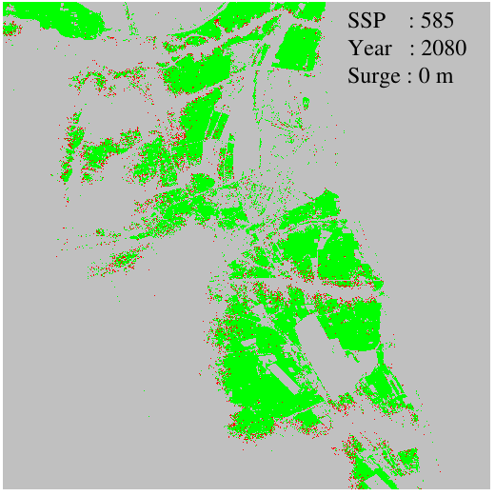
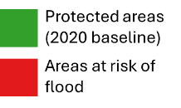
Inundation Maps: variation between 2080 and 2150
Notes:
Every time a new what-if scenario is set up, an inundation map will be displayed, with the flooded areas in red and the protected areas in green.

Slide 15
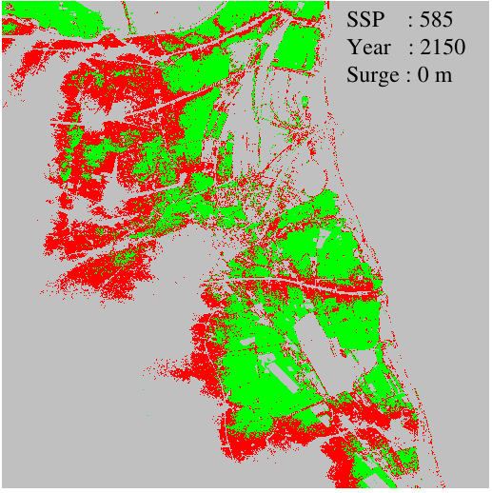
Inundation Maps: variation between 2080 and 2150

Slide 16
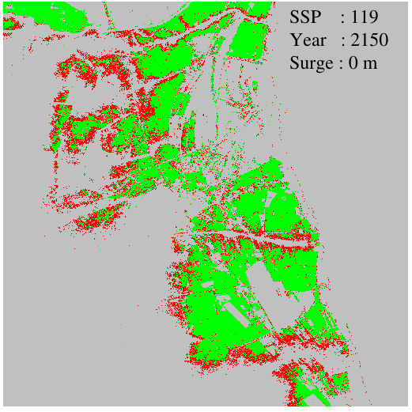
Inundation Maps: variation due to different storm surge height

Slide 17
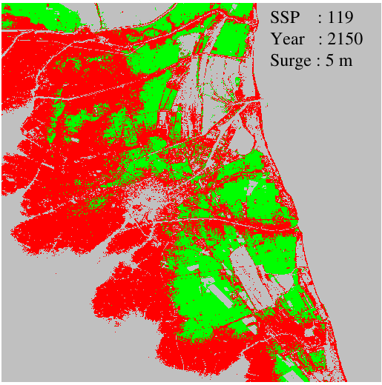
Inundation Maps: variation due to different storm surge height

Slide 18
Fixed SSP 245 and Storm Surge at 1m (medium confidence level)

Slide 19
Fixed storm surge at 1m and year 2080 (medium confidence level)

Slide 20
Fixed year to 2080 and SSP 245 (medium confidence level)

Slide 21
Fixed year 2080, SSP 245 and Storm Surge at 1m

Slide 22
Integration with DestinE
High Resolution European Use Case
Climate Change Adaptation DT
10m DTM
Notes:
The service capabilities will be greatly enhanced with the implementation of the DestinE service. The inundation products in Europe will be more robust and higher in resolution thanks to the 10m digital elevation model and the use of the sea level projections from the climate change adaptation digital twin, although at the moment only 2040 projections with a single scenario are available. But of course, as the layers of the digital twin are updated, the sea level rise and storm surges service will also be updated, thus allowing to produce flood maps for different years of interest as well as in areas outside of europe.
Use of Climate change adaptation DT (mean sea level , 2040, SSP (3-7.0)
scale up / follow on
Extension to other years (DT)
Extension to global areas if 10 DTM is available
Local assessment using higher resolution input data (automatic

Slide 23
The Impact of DestinE
One place to access a wide range of data
Dataset | Component
CAMS air quality forecast | Air
ERA-5 meteorological condition | Air
Landsat 8/9 thermal imagery | Heat
Sentinel-2 optical imagery | Heat, Infrastructures
Water quantity indicators | Flood
CAMS solar radiation | Flood
CLMS vegetation indices | Flood
CEMS River discharge | Flood
Dataset | Component
Copernicus Elevation Model | Sea level rise, Air
Climate Digital Twin | Air, Heat, Sea level rise, Flood, Resources
Eurostat Population distribution | Resources

Slide 24
The Impact of DestinE
The tools to scale-up
Initial demonstrators focus on specific cities
All the datasets have a global coverage
Building on an operational platform : scalability & efficient data access
Adapt to a growing number of instantiations across the globe

Slide 25
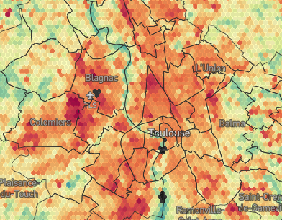
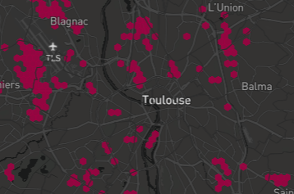
Urban heat
Focus: Urban Heat component built upon DestinE data lake and Climate Change Adaptation Digital Twin
Urban heat island mapping
Thermal imagery
(Landsat 8/9)
Air Temperature (ERA-5)
Land Cover
(ESA WorldCover)
Data processing
& fusion

Slide 26
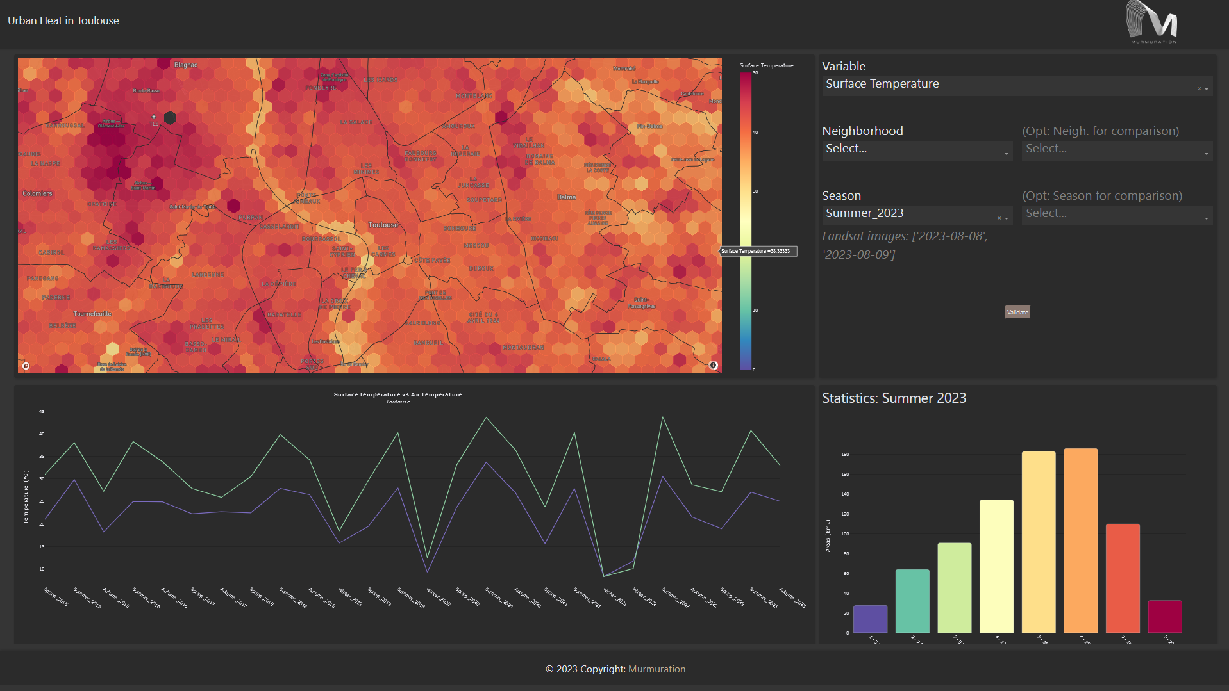
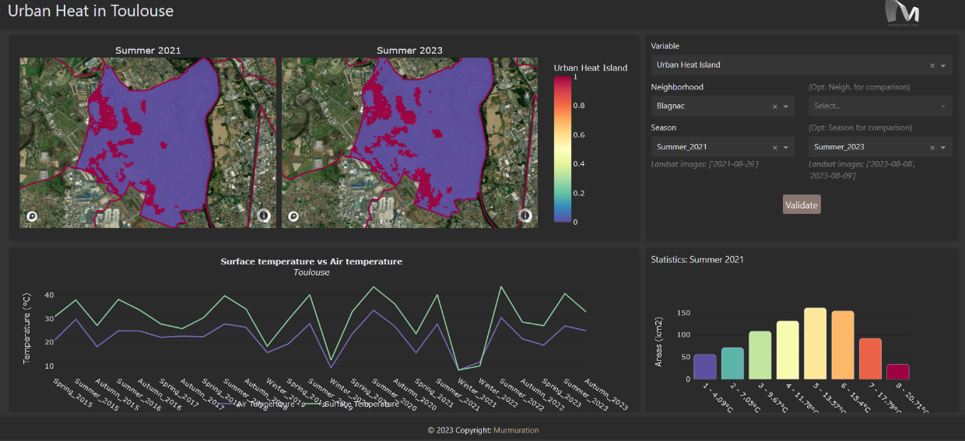
Urban heat
Demo

Slide 27
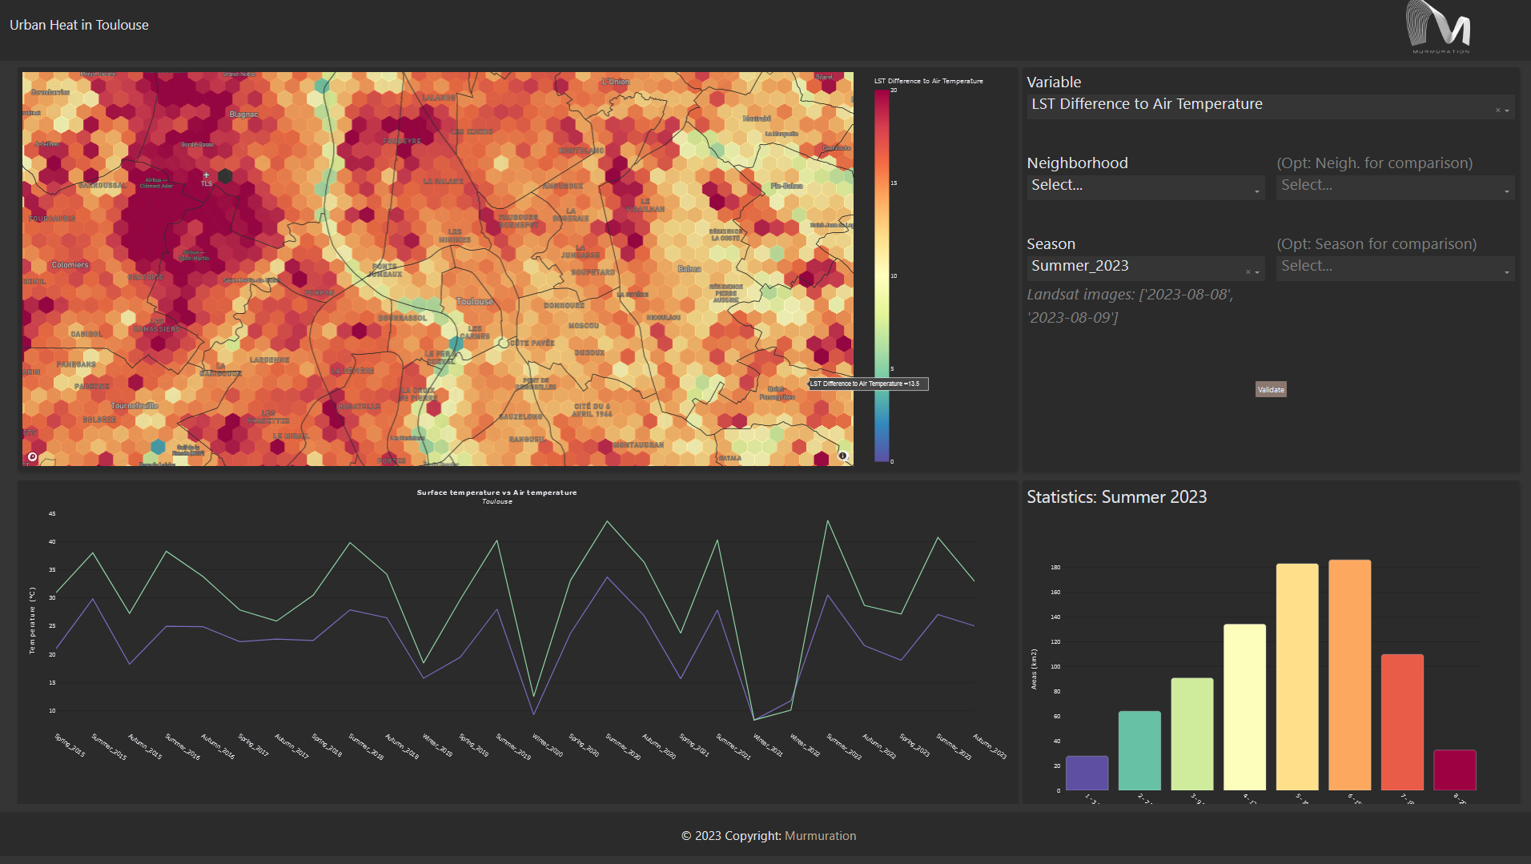
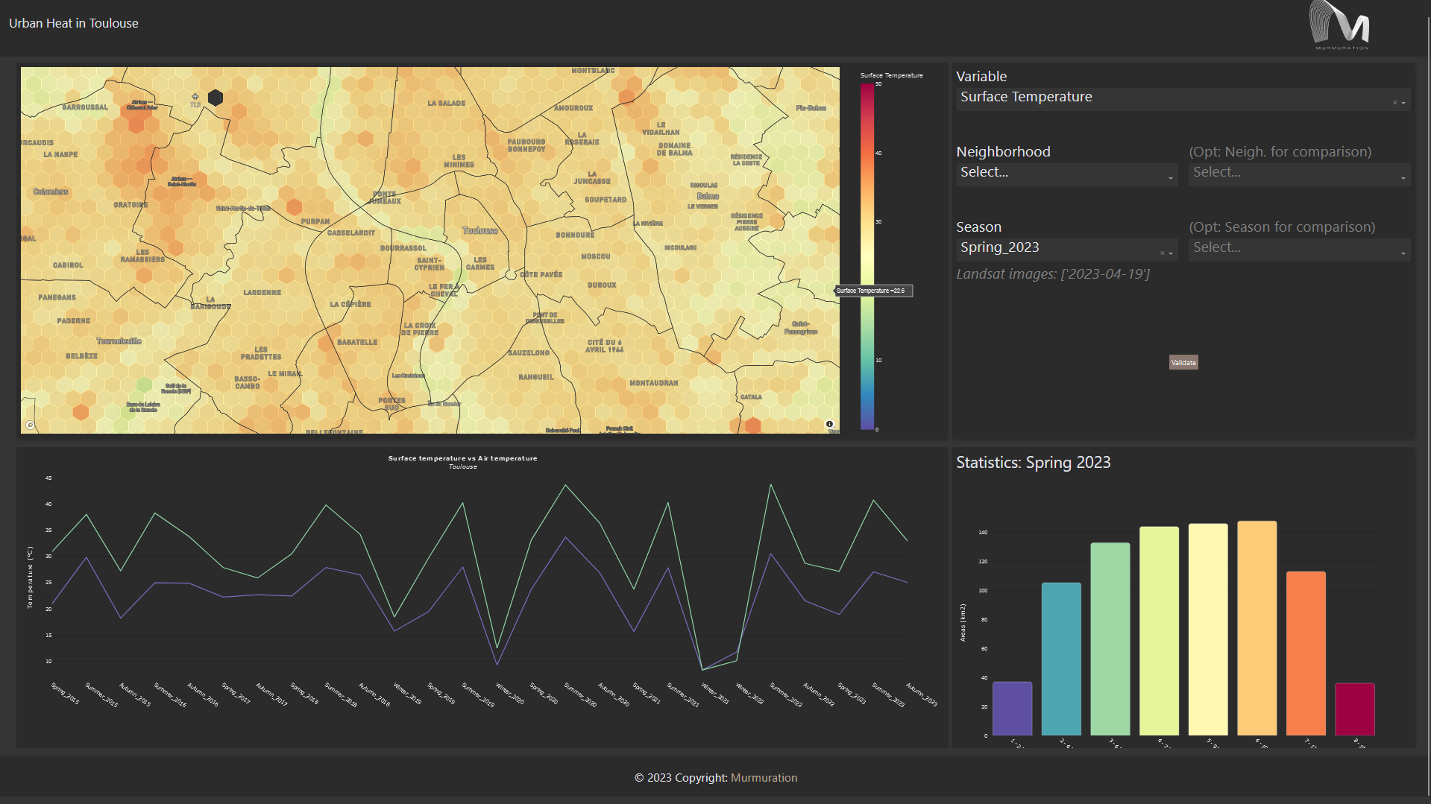
Urban heat
Demo

Slide 28
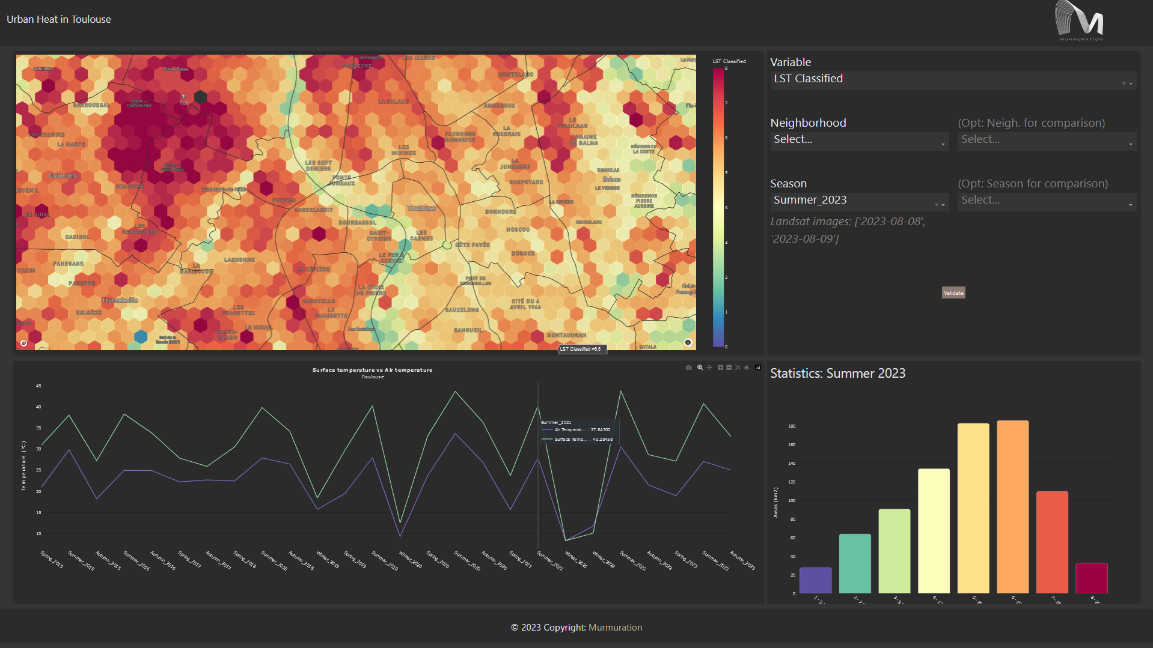
Urban heat

Slide 29
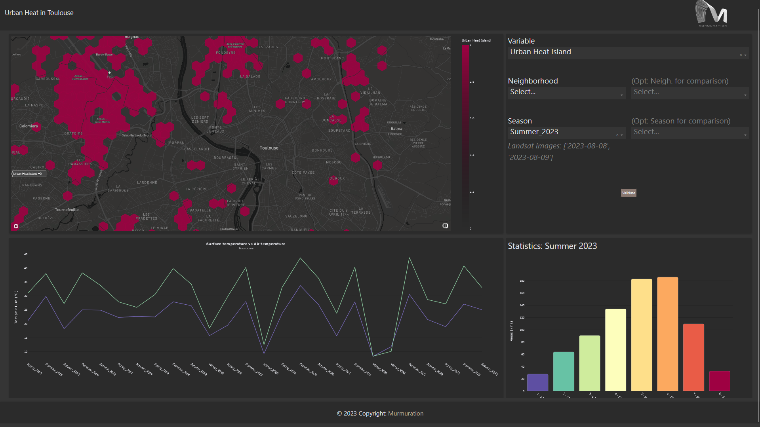
Urban heat

Slide 30
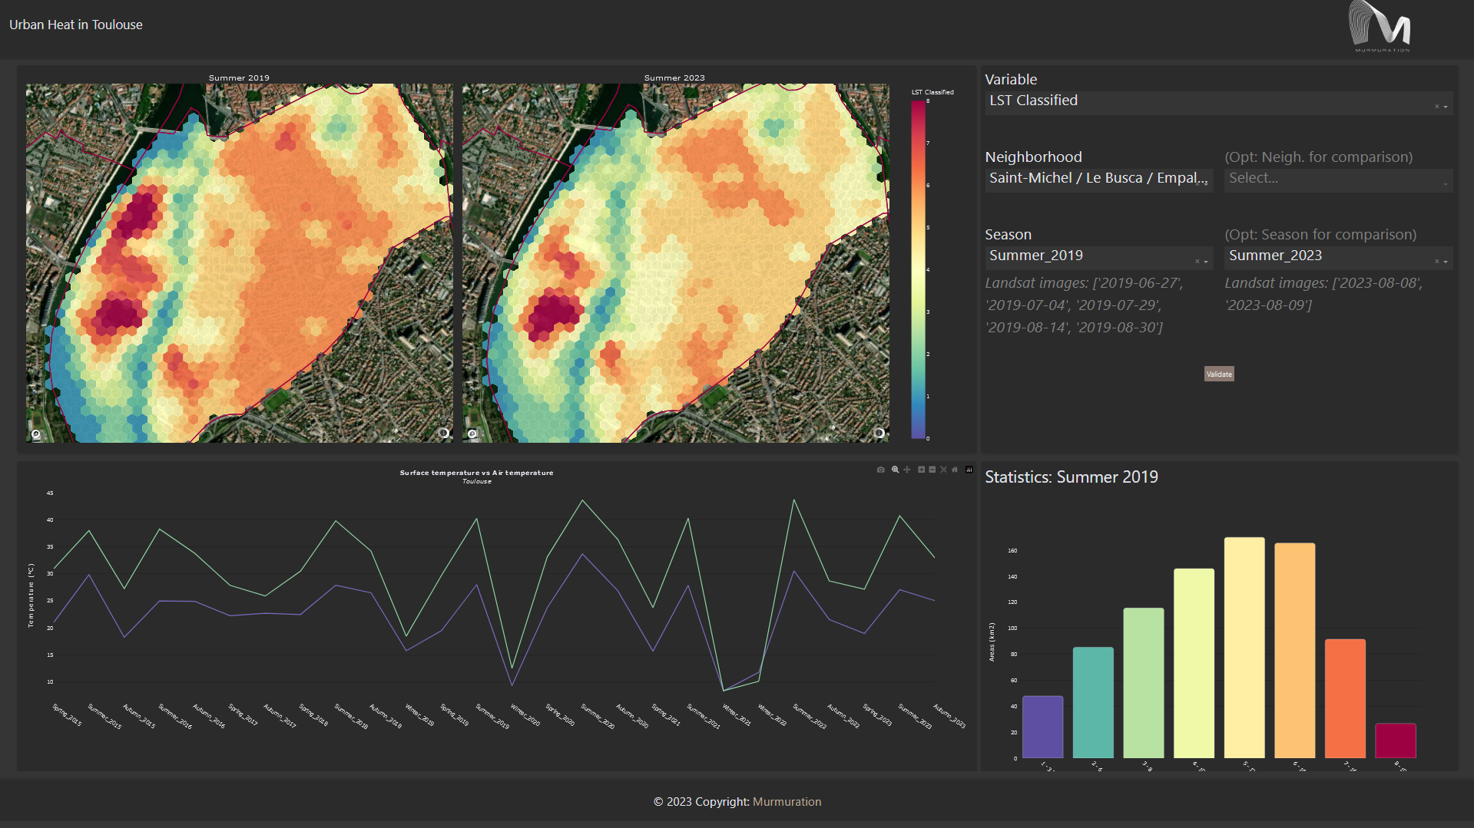
Urban heat

Slide 31
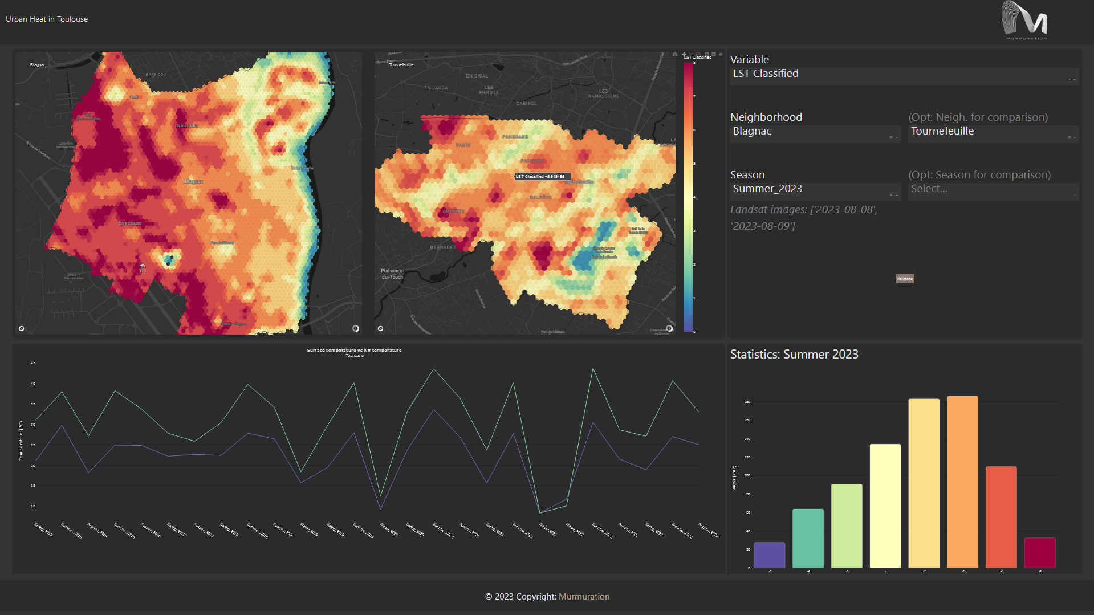
Urban heat

Slide 32
Urban heat
Next steps
Data
Historical and projection data from ERA5, Landsat, and DestinE Climate Change DT.
Modelling
Pixel-wise linear regression models to link air temperature to ground surface temperature.
Determine the urban heat island extent according to air temperature conditions
Projections
Annual days exceeding 30°C, 35°C, 40°C, and 45°C according to Climate DT scenarios
Urban heat island projections under the probable future conditions

Slide 33
The plan for scale-up
How UrbanSquare can have a wider impact
Coherent, integrated offering, defined by user needs
Building trust and providing evidence of the accuracy available
Scientific rigor combined with wide range of datasets
Continued stakeholder engagement
Information, knowledge exchange and training
Explaining the capabilities enabled by DestinE

Slide 34
The plan for scale-up
Understanding end-user needs
Differentiating needs of operational agencies and municipalities
Complementarity with existing capabilities
Identifying barriers to engagement with new tools and data
Tailoring of tools to local circumstances
Understanding the external drivers on planning and policy

Slide 35
Audience Q&A
Questions?

